Slide 1
AI-powered Nutrition Analyzer for Fitness Enthusiasts

Slide 2
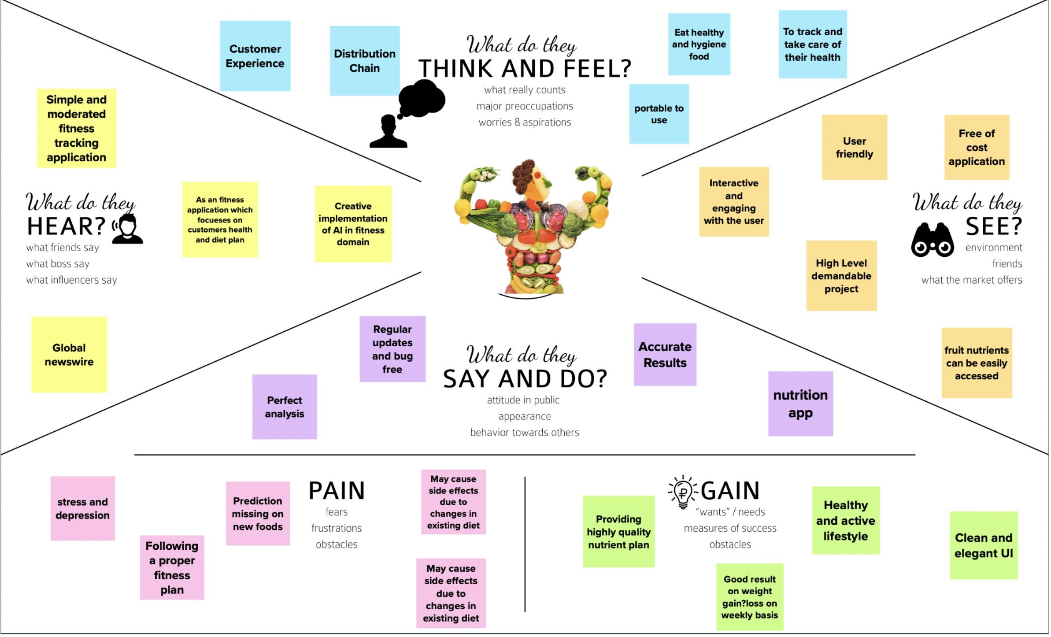
Empathy Map

Slide 3
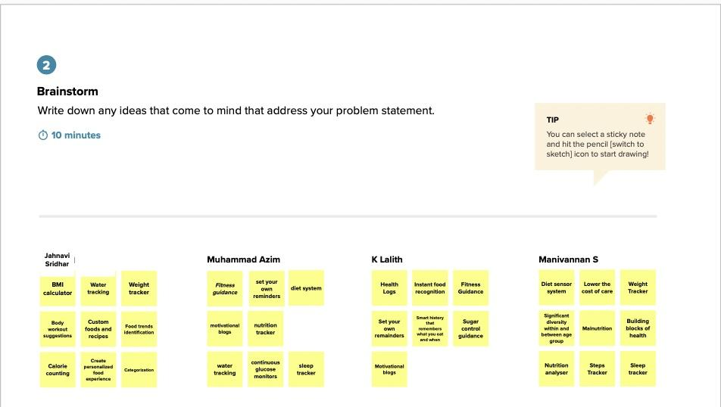
BrainStorming

Slide 4
Thank you

